Slide 1


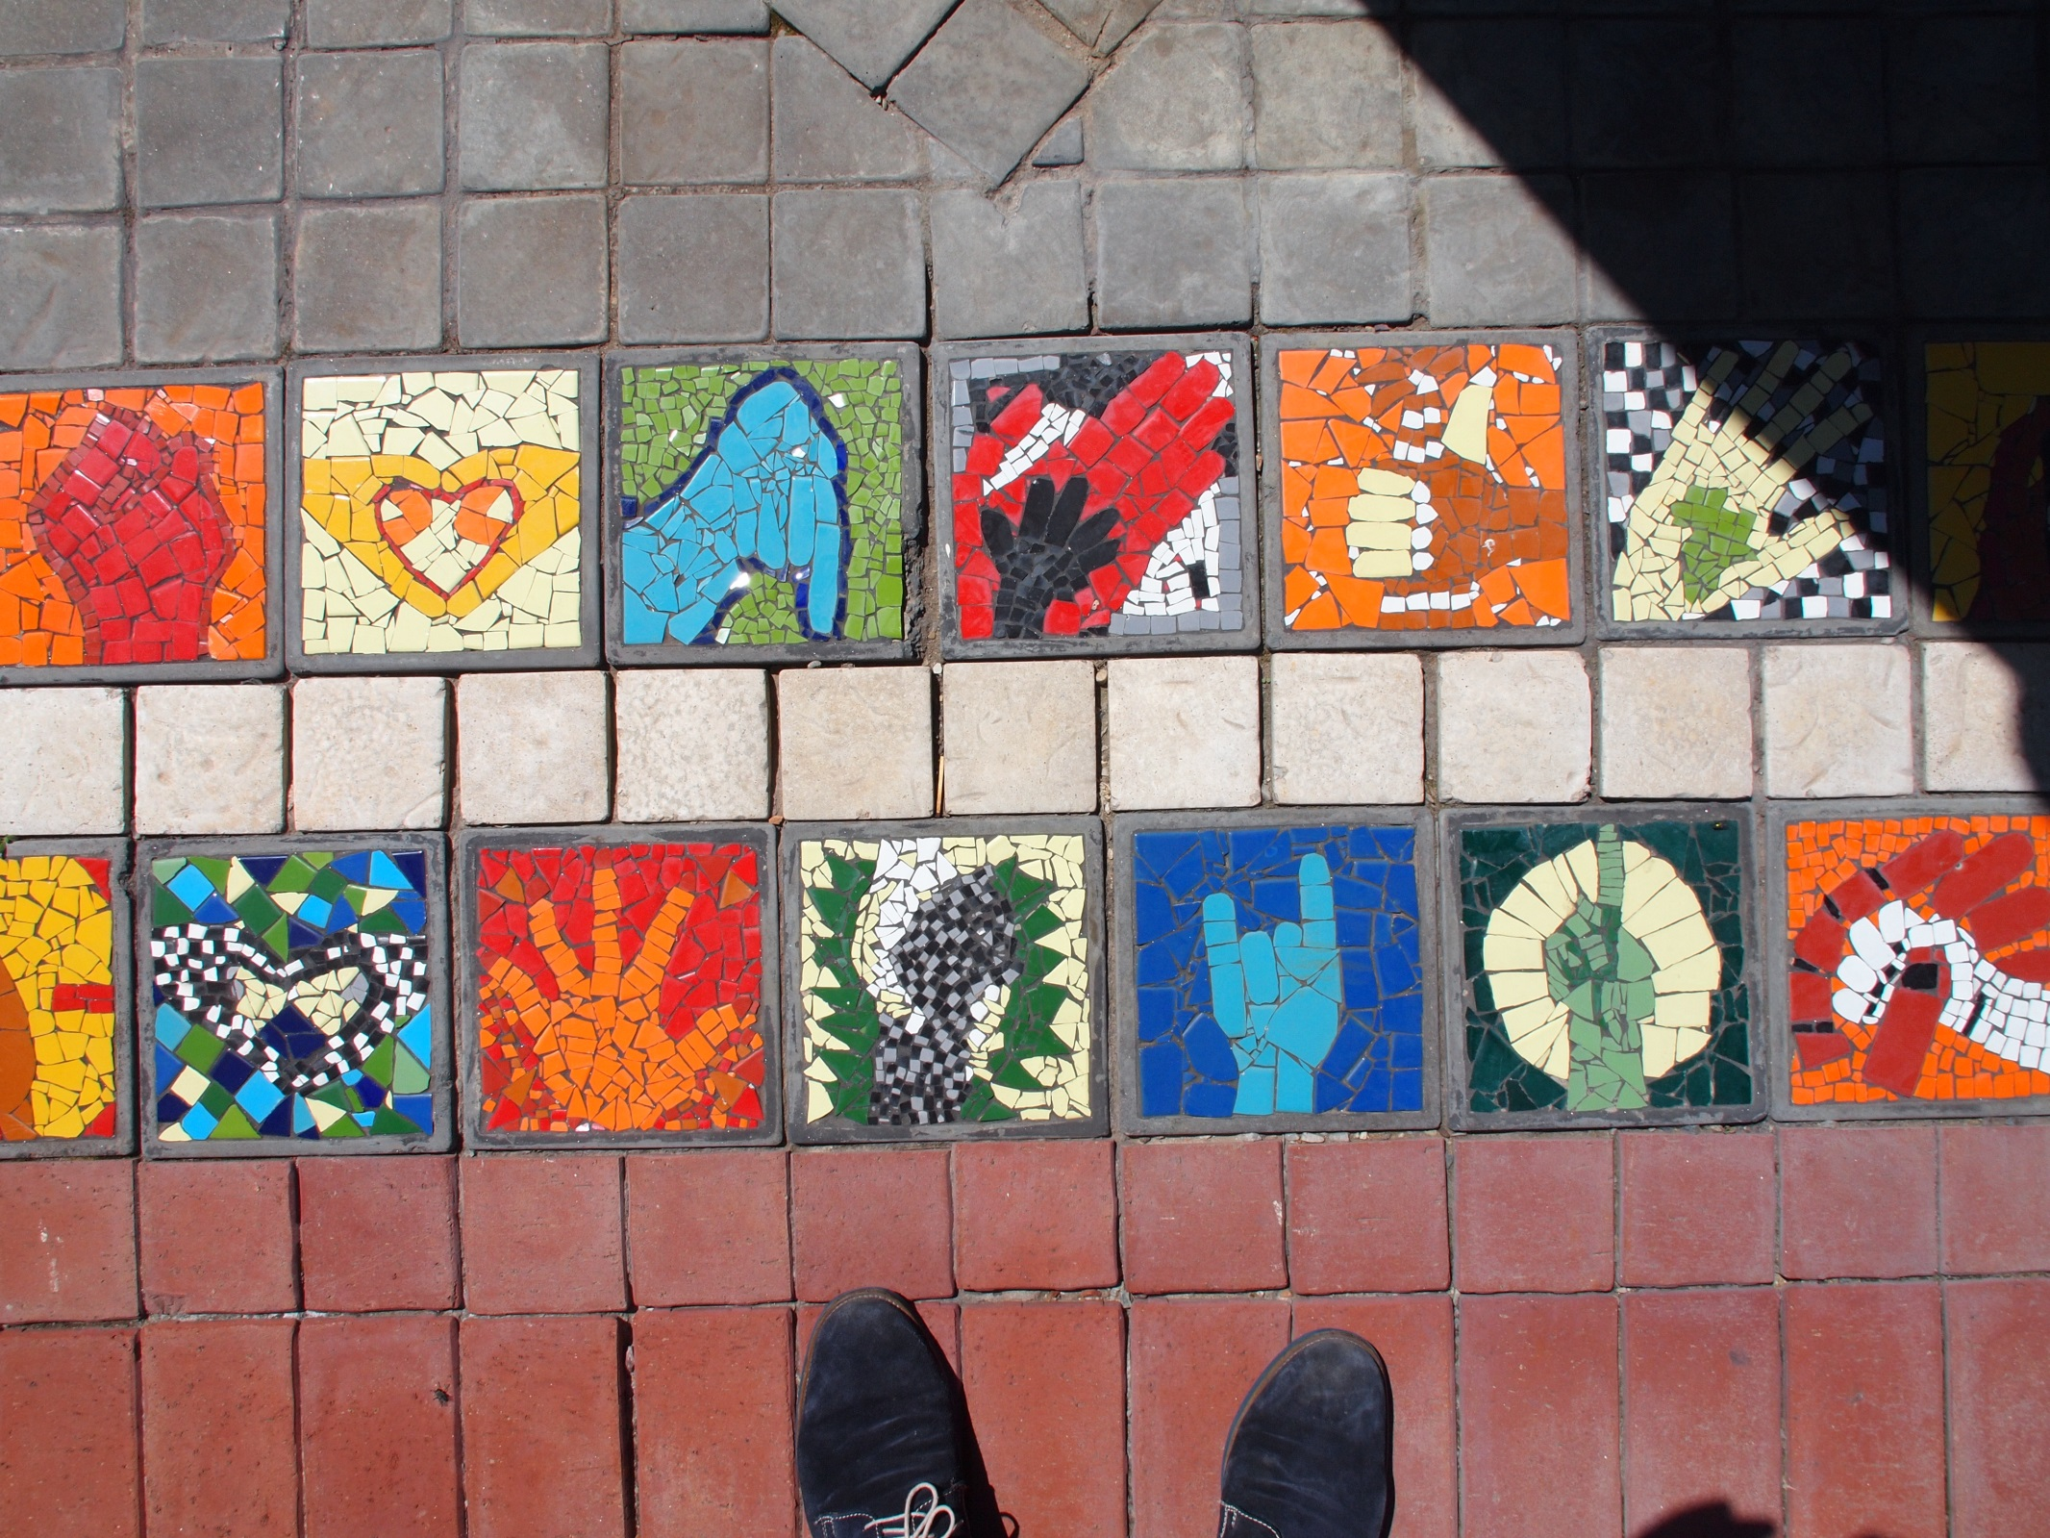
Nelson Mandela Bay Gothenburg
Partnership
1 NOVEMBER 2016

Slide 2
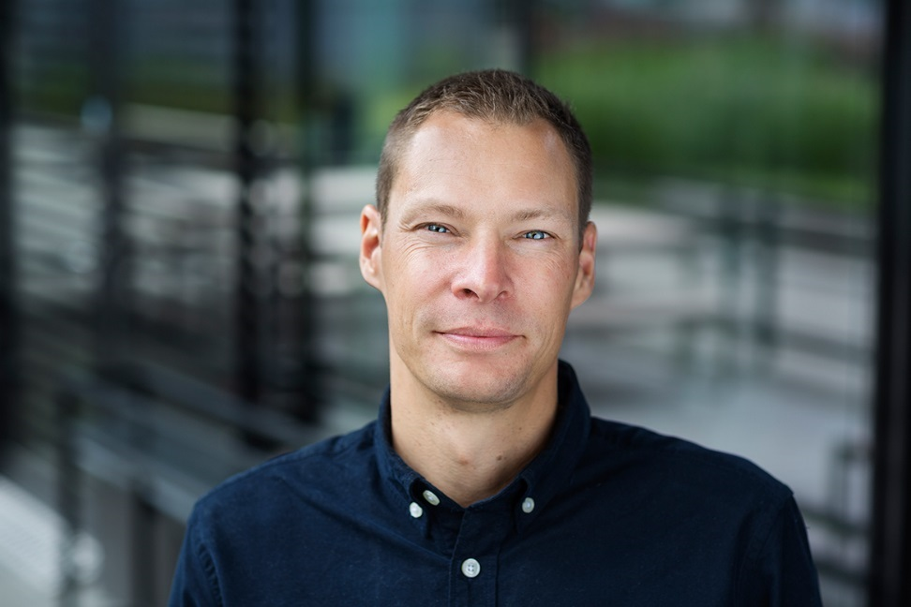
Content coordinator
Strategic planner at AB Framtiden – tidiga skeden.
Assistant project manager for the “Development strategy Gothenburg 2035” and the “housing in Gothenburg - current state and future direction”.
Content coordinator in the Gothenburg partnership with Nelson Mandela Bay Municipality (NMBM).

Slide 3

INSTITUTIONAL ARRANGEMENTS – ENSURING SUCCESS
ICLD
Gothenburg
Municipality
Joint Partnership Management
Committee
Nelson Mandela Bay
Municipality
COO
Content Co-Ordinator
Partnership Co-Ordinator
Partnership
Co-Ordinator
Content Co-Ordinator
Project
Team
Project
Team

Slide 4
Contents
About the partnership
Previous collaborations within the partnership
Upcoming theme – accessible cities – actions for improved economy and social cohesion
Gothenburg development strategy 2035 – from strategy level to operational level?
The need for research – ”the tactical level”

Slide 5
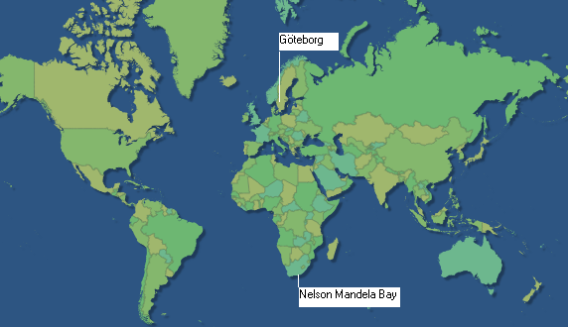

Slide 6
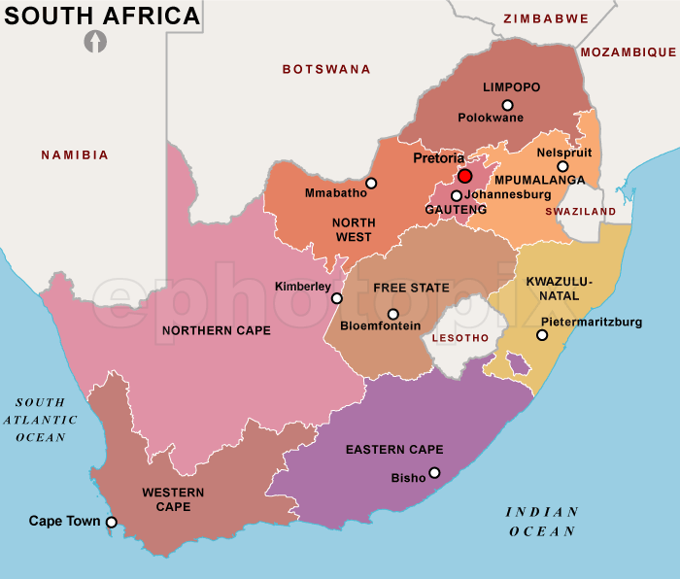
Nelson Mandela Bay

Slide 7
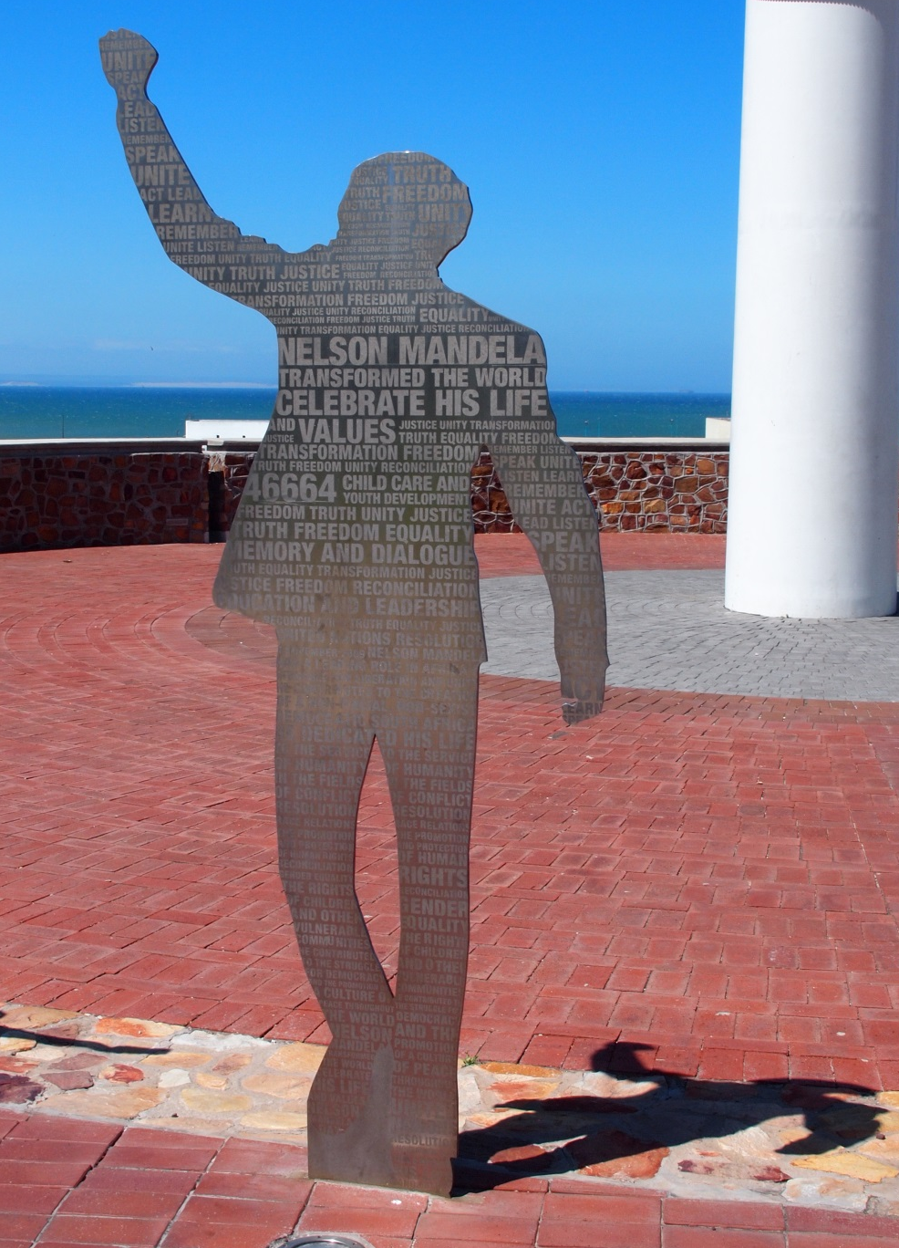
The Context
Differences in …
geographic
climatic
historic
political/governmental
institutional
legislative
urban
But many similar challenges and solutions.

Slide 8
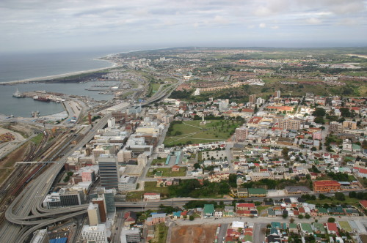

Slide 9
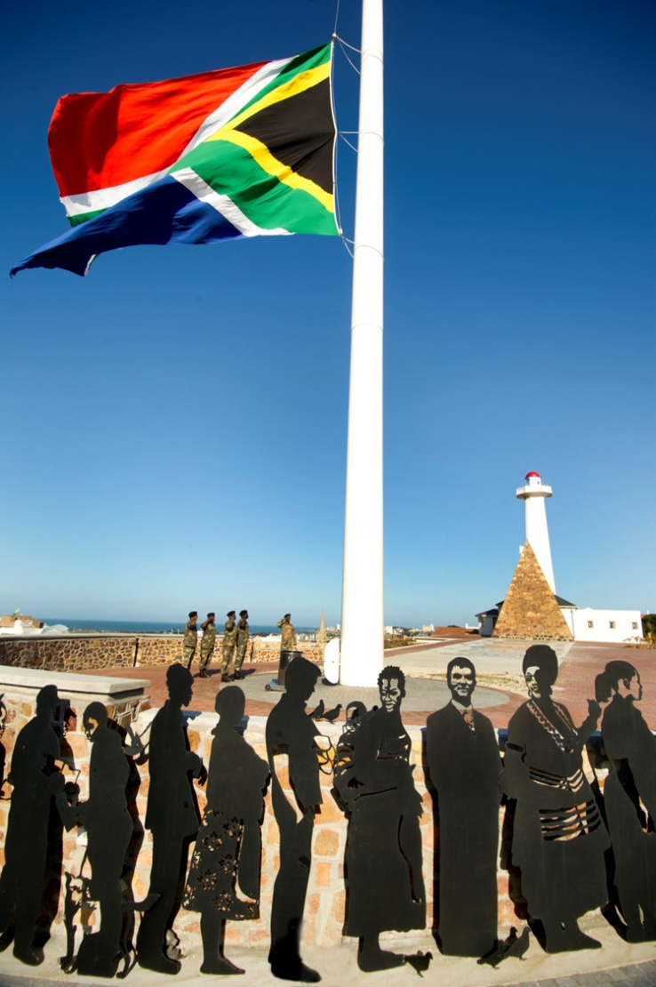
A brief history
1994 -The advent of democracy in South Africa
Sweden /South Africa Urban Development Programme
Sida (Swedish International Development Cooperation Agency) focus - reconstruction and development in S.A.
City focus
Impact of rapid urbanisation
Need to achieve integration of S.A. societies

Slide 10
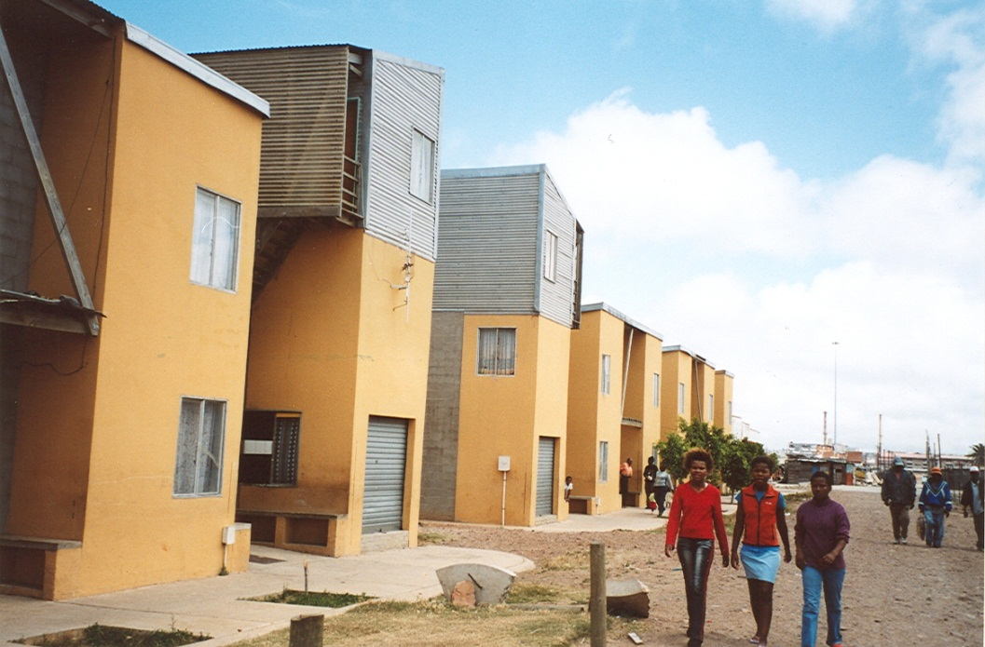
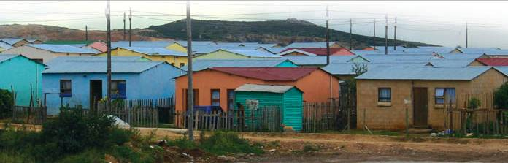
Sida Urban Development Programme
1996 – 2006
Resident Urban Advisors
Innovative housing
Transport
Street lighting and infrastructure
Environment
Gender
Urban planning

Slide 11
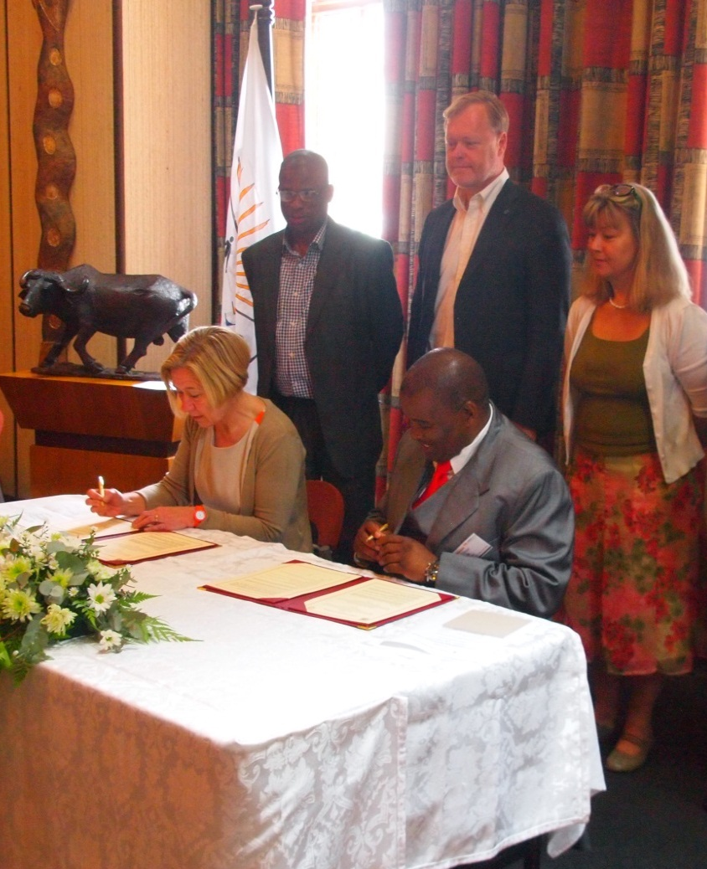
1999- Partnership concept introduced
The first formal relationship between cities was signed on 23 November 1999.
Twinning is a requirement for funding:
  Cooperation between equal partners
  Reciprocity
  Project based collaboration;
  Requirement for a Management Committee
Focus on :-
mutual learning, best practice, problem solving, beneficial exchange of knowledge and experience.
Partnership renewal 2012

Slide 12
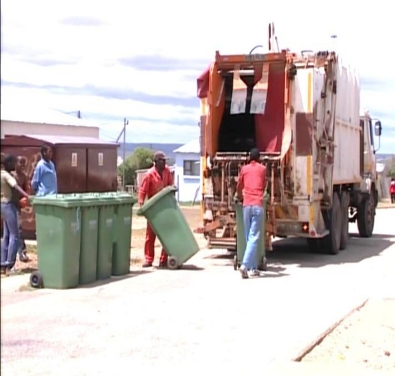
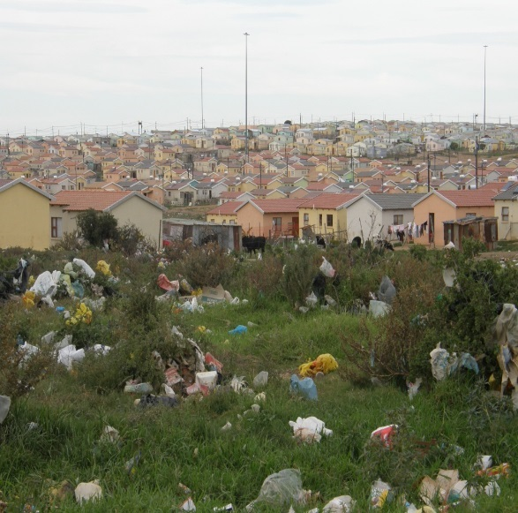
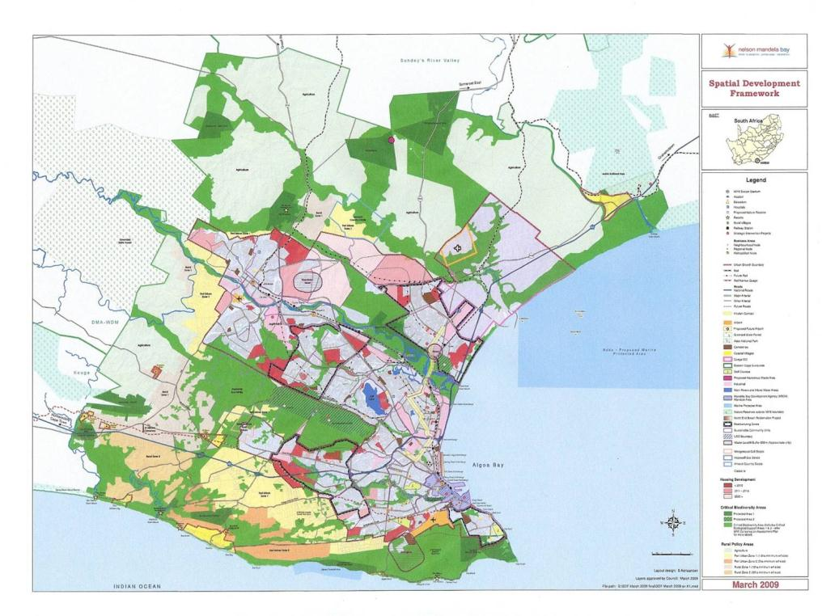
Some of the many project examples.
Spatial framework
Public transport Plan and transport models
Street lighting
Motherwell urban renewal and innovative housing
Pavement management
Integrated waste management.

Slide 13
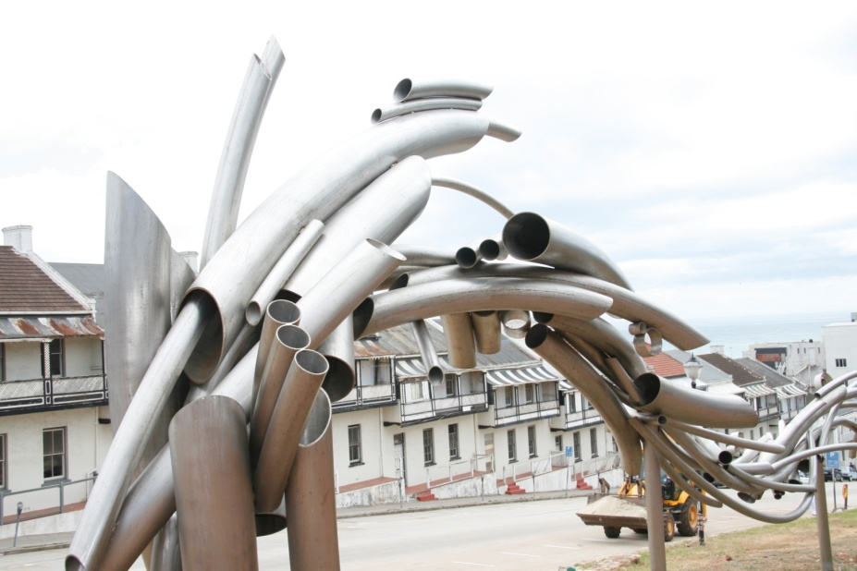
Post 2012- Partnership Model
  Time for new energy and perspective - a more integrated approach in both cities.
Deliberate synergy between the
projects
The projects are to support the
cities visions
Projects are designed around
common aims and objectives

Slide 14

The Overarching Project:
”Examination of the gap between policy and implementation in local government”
OVERALL OBJECTIVE
To have more effective implementation of all policies and strategies within a city context in order to improve service delivery at a local level. This in turn will ensure a more sustainable and integrated city.
PROJECT OBJECTIVE
To develop a tool kit for our and other local authorities to ensure optimal policy implementation and service delivery

Slide 15
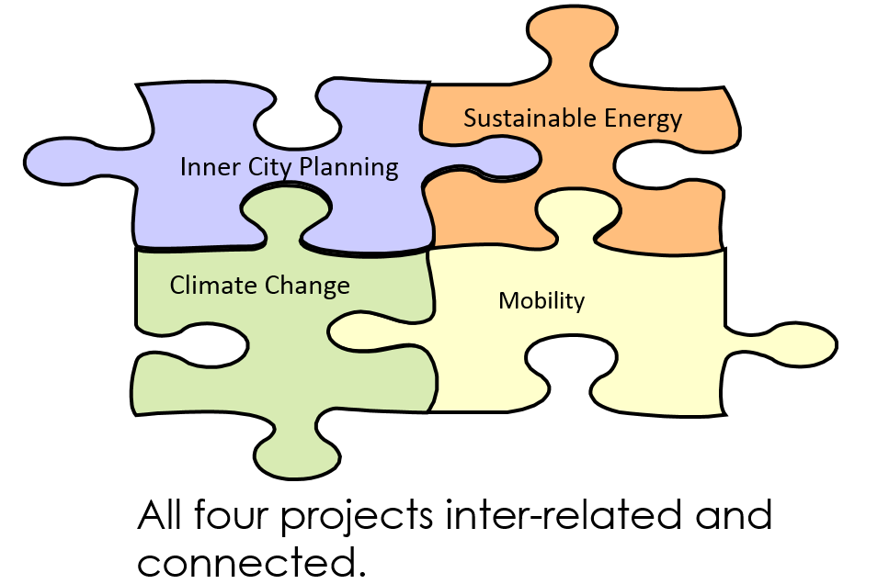
2013-2016
Management Committee – direct influence into project/participate in solutions
Overarching Project – policy/implementation gap
Project 1
Project 2
Project 3
Project 4
Interconnected and interrelated
Role of Management Committee has changed.
Technical +administrative + political issues explored;
organisations, budgets and prioritisation

Slide 18
Policy and action should not lose sight of each other

Slide 19
Future 2016 -
technical
ACCESSIBLE CITIES
Spatially
Economically
Socially/democrtatically
Notionally
governance
political
research

Slide 20
Accessible Cities
---------
Actions for improved economy and social cohesion
Recommendations for accessibility
in the creation of just cities
ACCESSIBLE CITIES

Slide 21
The idea
The living conditions in Gothenburg and Nelson Mandela Bay can be improved by all the work undertaken in current and future urban developments. We need to ensure that investments are as effective as possible to realise our visions/goals. How can we maximise the scarce resources to realise just cities.
We will examine how the conditions within suburban areas, and the relations between suburban areas and other parts of the cities, can be improved in order to create better economies (reduce poverty), social cohesion (increased democracy - a city for all) and resilience (climate proof).
The project will focus will be on democratic, economic, spatial and environmental issues. The key word is accessible.
ACCESSIBLE CITIES

Slide 22
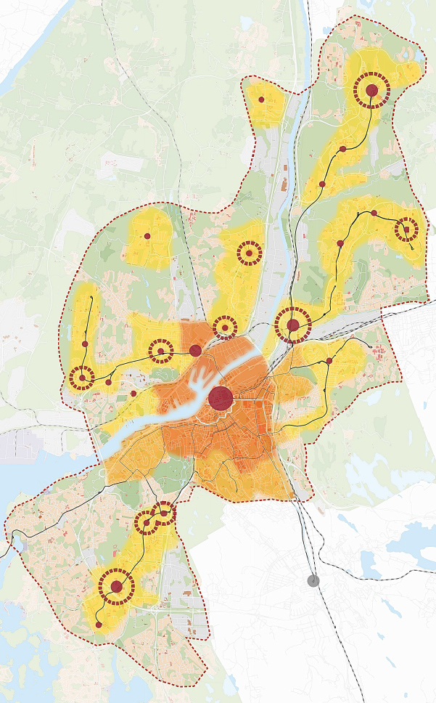

Development strategy, City of Gothenburg 2035
A summary of development strategies for Nodes and urban areas in the central and intermediate city
www.goteborg.se/stadsutveckling2035
Notes:
Inom det här området bor 460 000 Göteborgare. 90 % eller 9 av 10 Göteborgare.
Här finns nästan 90 % (85 %) av alla stadens arbetstillfällen.
Inom kärnan drygt 150 000 inv. (30 %) (beroende på avgränsning) och drygt 50 % av alla arbetstillfällen.
Inom mellanstaden bor drygt 340 000 invånare. (60 %)
Vilken utbyggnad pågår och planerat till 2020-talet? Hur påverkar det tätheten?
Mark för bostäder efter 2020?
Var gör utbyggnad och satsningar bäst nytta?
Hur får Göteborgs invånare bäst samlad nytta av utbyggnaden?
På vilka grunder skall prioriteringar mellan olika platser ske?

Slide 23
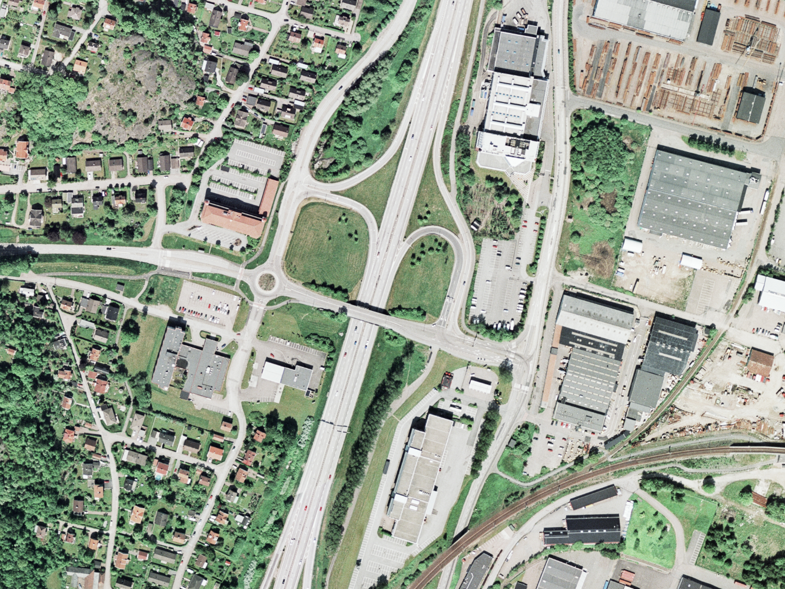
Notes:
Ett par kilometer utanför kärnan finns andra miljöer. Här finns ett stort behov av att läka olika stadsmiljöer inom mellanstaden/närförorter.

Slide 24
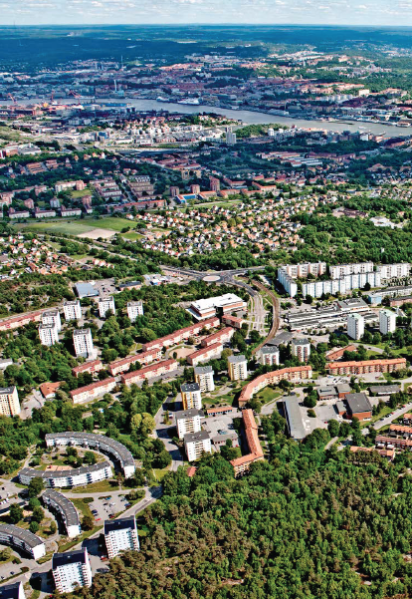
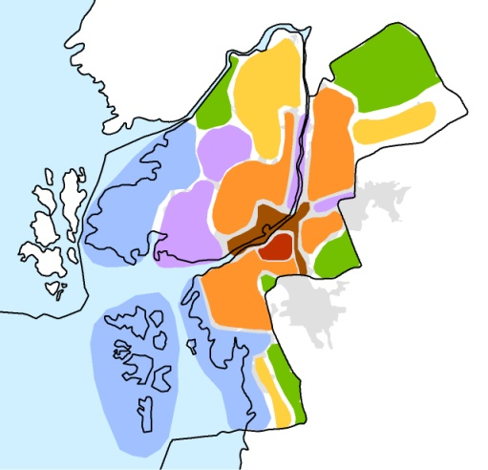
Pictures of urban areas in the intermediate city
Notes:
Men framförallt - Här finns mängder av trafikseparerade områden som byggts ut i snabb takt under 60- och 70-talet och som nu är i stort behov av förändring och vitalisering.

Slide 25
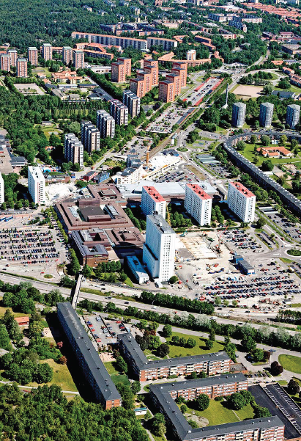
Pictures of urban areas in the intermediate city
Notes:
Men framförallt - Här finns mängder av trafikseparerade områden som byggts ut i snabb takt under 60- och 70-talet och som nu är i stort behov av förändring och vitalisering.

Slide 26
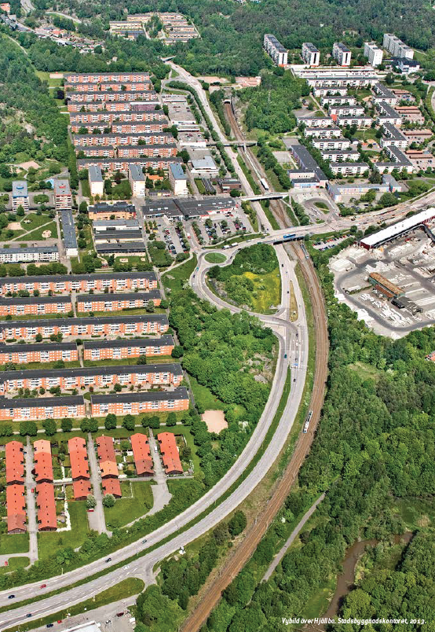
Pictures of urban areas in the intermediate city
Notes:
Här finns monofunktionella miljöer som är mer sovstad nu än tidigare. Områden som successivt reducerats på service. I stort behov av en 2.0 satsning. Här är inte enbart bostadsbrist utan även stadsbrist.

Slide 27
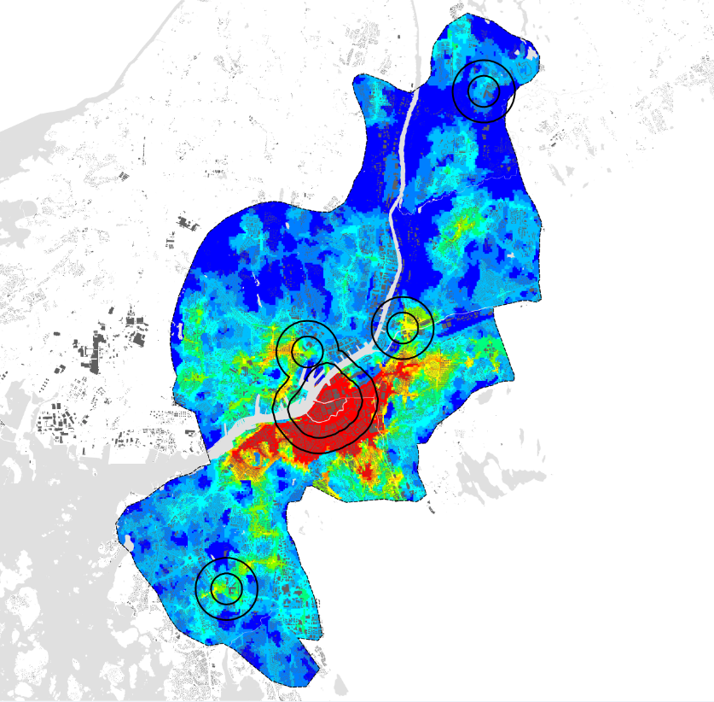
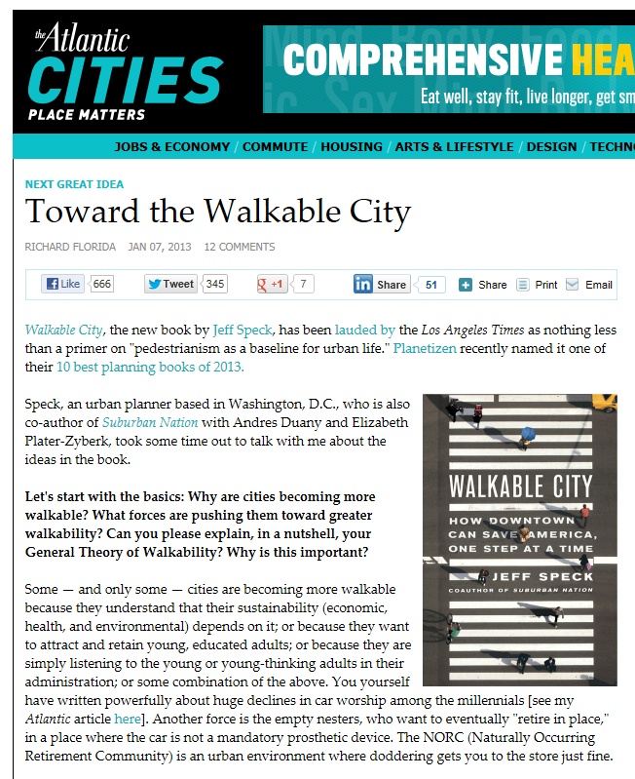
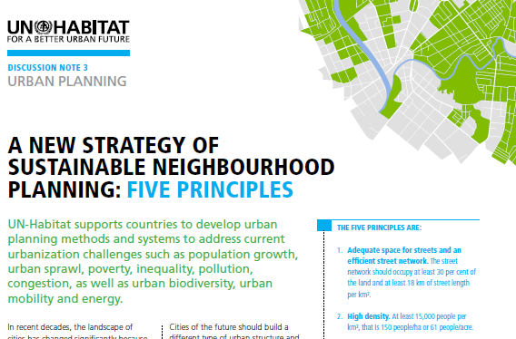
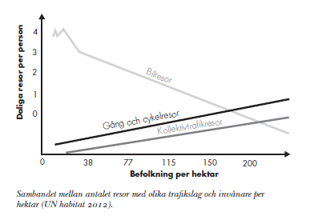
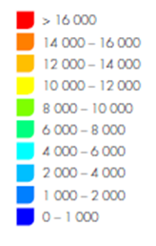
The pedestrian-friendly city requires density
Health
economy
Urband life & attractiveness
Safety / security
Notes:
Vad förändras genom att bygga i olika täta miljöer?

Slide 28
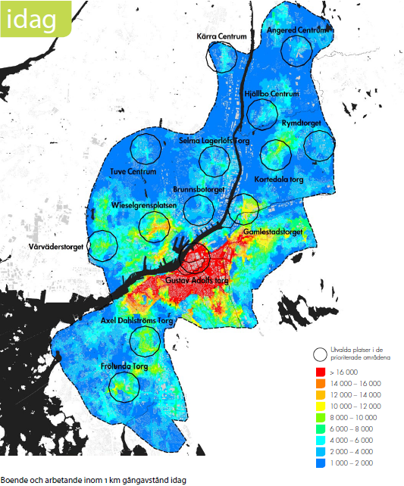
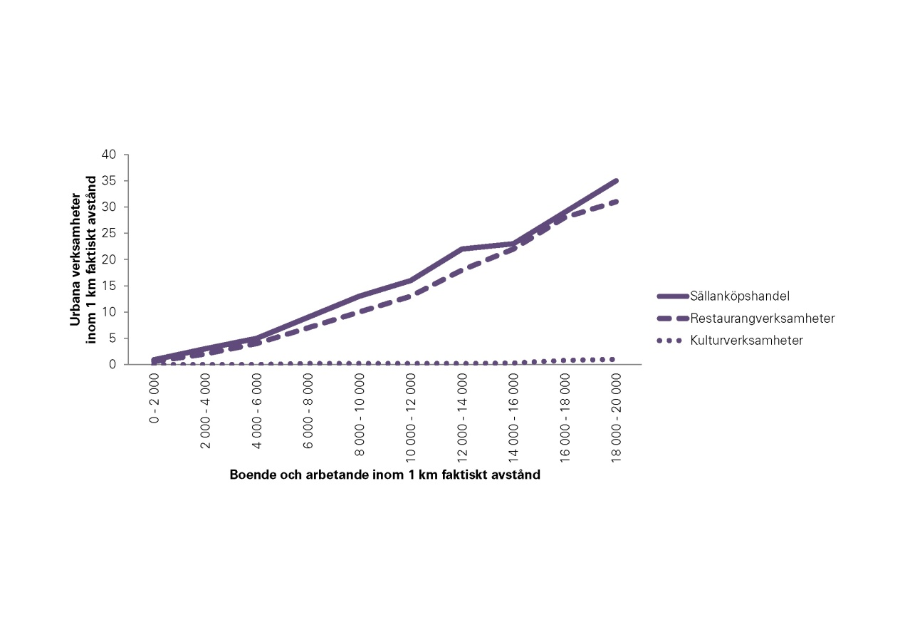
Density, service base and range of urban activities?

Slide 29
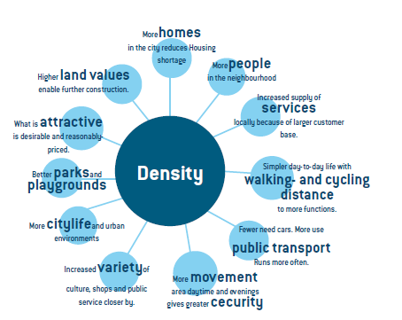
Everyday life improvement

Slide 30
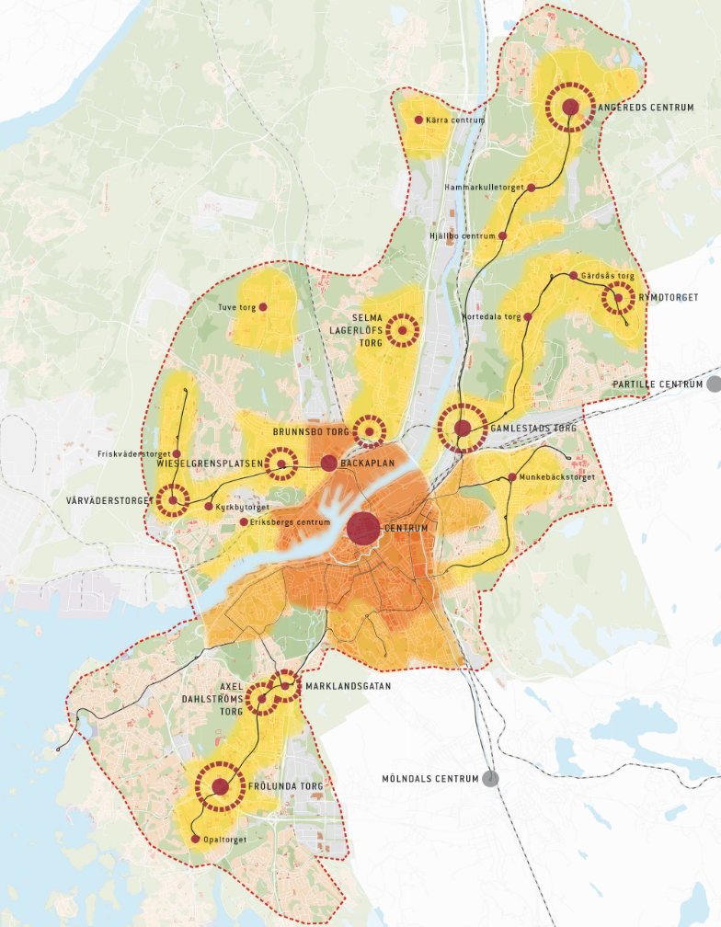
The map shows vision and strategy:
Make use of what we have already (urban areas)
Develop central points/nodes
Make the biggest effort where it makes the most difference (Mustering strength areas)
Notes:
Hur har vi valt ut dessa områden och platser?
Här gör ny bebyggelse störst skillnad
Här finns en förhållandevis hög täthet med människor redan
Här finns god kollektivtrafik
Hur förhåller vi oss till områdena utanför? Finns det rätt och fel?

Slide 31
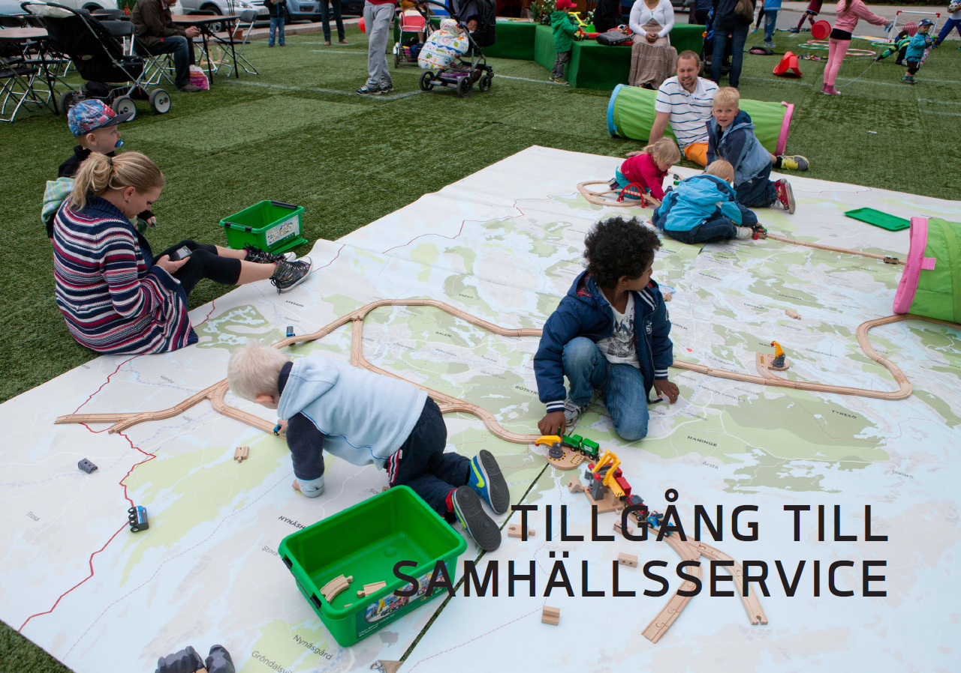
Notes:
Vem är jag och varför pratar jag om detta? Och därefter koppla in på tillgångsbegreppet..

Slide 32
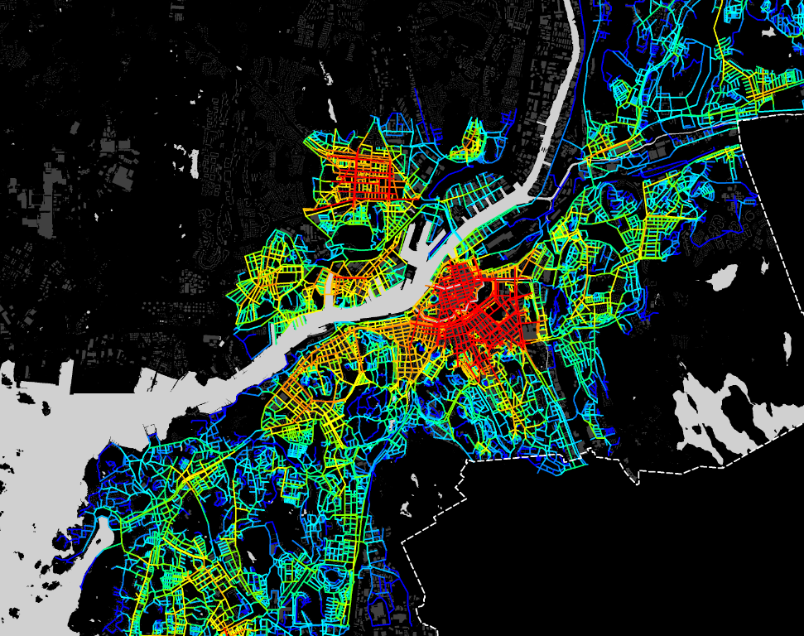
A coherent and interconnected city that works?
Notes:
Lars Marcus, space syntax, UP – utpekade lägen, Stomkoll investeringar, nya hållplatser, nya flöden, omdanande stråk, överbyggda barriärer etc.
Rätt investeringar i rätt lägen med rätt kvaliteter ger kraft.. Mer pang för pengarna..

Slide 33

Why now?
There is momentum coming years, with long-term urban development strategies (2035) that is being concretised and lack of information on the long-term service needs on a aggregate level. (= Risks).

Slide 34

Great acceleration in investment in public services and various multi-functional venues - but what is really coordinated?
Library
swimming arena
Schools and pavilions
Preschools and temporary planning permission
Retirement and BMSS
sports Facilities
Recycling centers,
Bus depots, etc ..
New public transportplan 2035
Notes:
Det talas om 36 nya skolor kommande 10 år, ej inräknat de som behöver ersättas av byggnadstekniska skäl.. Det går ca 2000 elever i paviljonger idag. Hur säkras ”bra” lägen tillsammans med stadsdelarna? En mindre fördyring på 20-30 miljoner för ett nybygge kan användas till 4 extra lärare under 10 år..
4 av 4 nya skolor måste bli rätt och göra och generera nytta…

Slide 35
METROPOLITAN SPATIAL DEVELOPMENT FRAMEWORK
1950 km²
62% Natural and Conservation Areas
117 km Coastline
38% Urban / Agricultural

Slide 36
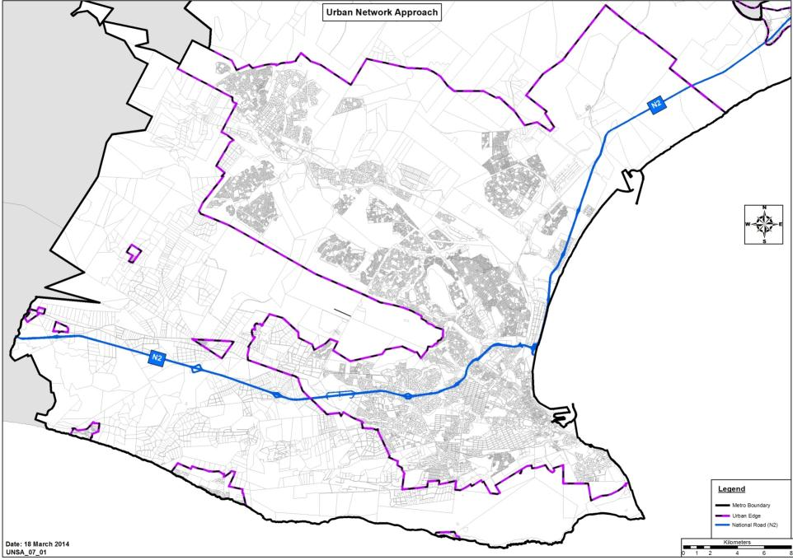
DEMOGRAPHIC INFORMATION: CLUSTER DENSITIES
Households / Hectare (hh/ha)
Uitenhage
Despatch
Kwanobuhle
Bloemendal
8.90 hh/ha
Motherwell / Wells Estate
14.57 hh/ha
Ibhayi / Bethelsdorp
20.16 hh/ha
N2 / Western Areas
3.97 hh/ha
CBD
5.71 hh/ha
Southern Areas
3.91hh/ha

Slide 37
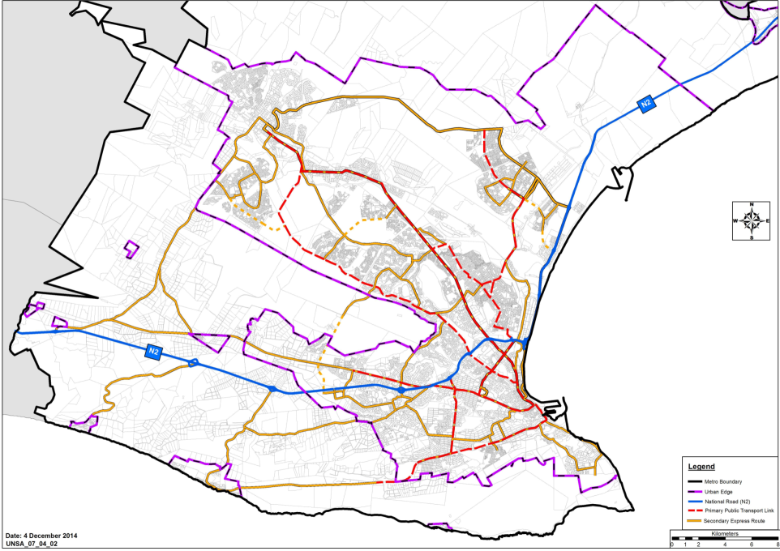

UNS: Urban Network Elements
With Priority Housing Areas
5
R334
R335
CDC
U
UD
S4
MM
4
D
S/Hub
3
6
Legend
R368
Metro Boundary
S3
R102
Urban Edge
Activity Corridors
R334
Hub2
R75
Existing Rail
8
R367
S5
Future Rail
7
National Road (N2)
Emerging Corridors
S1
Primary Roads
Urban Hubs
IZ3
9
Hub1
Metropolitan CBD
Linkages between Hubs
R102
IZ2
11
10
DP
Sub-Metropolitan Nodes
S3
Secondary Hubs
12
SD
S2
S/ Hub
Special Secondary Urban Hub
Township/ Urban Clusters
IZ
Integration Zones
GB
13
Industrial Nodes
Priority Housing Areas
(Mega Projects)
NE
Directional Flow on N2
28
14
Local Node
29
27
R102
15
IZ1
District Node
26
25
23
PE CBD
Regional Node
M9
IZ4
M12
24
22
M7
16
18
M9
21
20
17
IZ5
19

Slide 38
Catalytic Projects in relation to Urban Hubs and Integration Zones
S4
13
Legend
Zanemvula Hub
Metro Boundary
S3
7
Urban Edge
NMBM CATALYTIC PROJECTS
1 | Mermaid’s Precinct
2 | Lower Baakens Valley
3 | Happy Valley Precinct
4 | Njoli Nodal Interchange/ Precinct Design
5 | Ibhayi Township Hub Precinct Design
6 | Red Location Township Hub
7 | Bloemendal Arterial
8 | Zanemvula: Chatty Precinct Design
9 | Zanemvula: Chatty Link Road
10 | Zanemvula: Integrated Mixed Use
11 | IPTS Standford Road Phase 1
12 | Fairview West Integrated Development
13 | Motherwell Urban Hub Precinct Design
14 | N2 Node development
8
S5
Existing Rail
9
10
Future Rail
Njoli Hub
National Road (N2)
IZ3
S1
Primary Roads
5
1
Metropolitan CBD
11
4
Sub-Metropolitan Nodes
IZ2
S2
6
Urban Hubs
14
Linkages between Hubs
Secondary Hubs
IZ1
Special Urban Hubs
Integration Zones
IZ4
1
2
11
Catalytic Projects
12
3
IZ5

Slide 39
Result 1
Practical recommendations to implement in each city that deal with the further development of the suburban areas and other parts of the cities as well as the improvement of the linkages and relationship between them.
Ways to strengthen the local communities
Services/investment to be provided locally
Creation of long term resilient communities
Improve the relationship to the rest of the city for every citizen
Replicability for other projects during and after the project period
ACCESSIBLE CITIES

Slide 40
Result 2
A dedicated project linked to the main project that deals with youth democracy in order to demonstrate:
Find ways to accommodate youth perspectives in city governance and planning for accessibility
Better ways of working with communities
Empowering youth
Increasing leadership capacity amongst the youth in our project areas and elsewhere
ACCESSIBLE CITIES

Slide 41
Result 3
A research element that will give guidance regarding the above to achieve more accessible cities.
The research will result in practical recommendations in our projects
The research will cover democracy, economic, spatial and notional aspects of accessibility
The research will create a platform for future projects
ACCESSIBLE CITIES

Slide 42
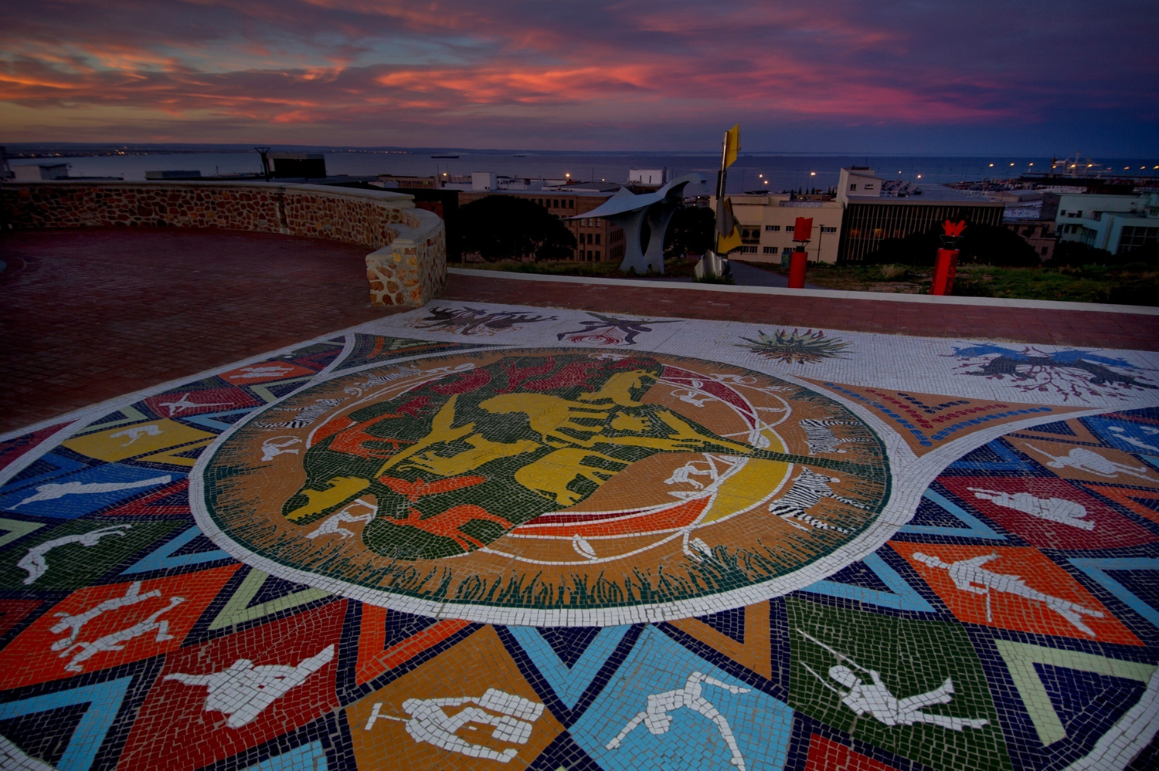
THANK YOU !

